Slide 1
SRA-001 | Module 1
INTRODUCTION TO HIJAMA
Definitions, Scope, and Professional Identity
SUNNAH REMEDIES · INSTITUTE OF PROPHETIC MEDICINE

Slide 2
Module Overview
01
What is Hijama?
Definitions, modalities, regulatory framework, and scope of practice for the Certified Hijama Practitioner.
02
The Hijama Practitioner
Role, responsibility, the Amanah Framework, Ihsan in practice, and the SRA Competency Framework.
SRA-001 | Certified Hijama Practitioner

Slide 3
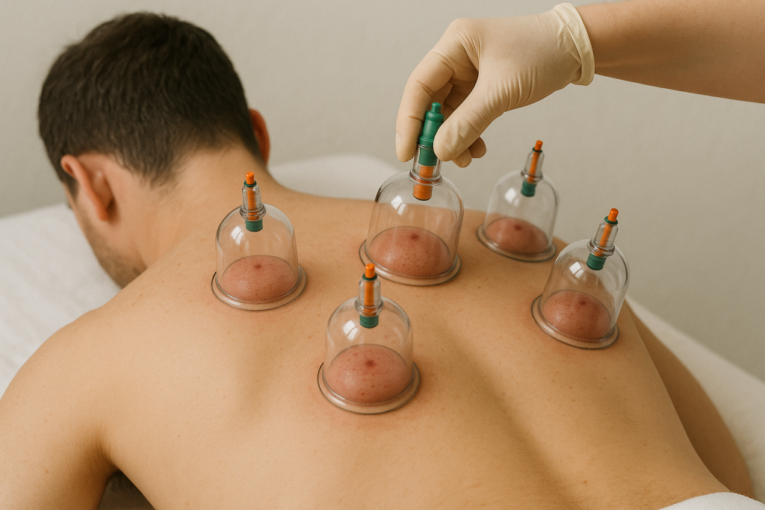
01
CHAPTER
What is Hijama?
Definitions, Modalities, and Regulatory Framework

Slide 4
M1 | SRA-001
Introduction to Hijama
SUNNAH REMEDIES
Defining Hijama: Wet Cupping Therapy
CLINICAL DEFINITION
Hijama (wet cupping) is a therapeutic procedure involving controlled superficial incision of the skin, followed by the application of negative pressure via a suction cup, resulting in the extraction of blood from the superficial capillary network.
"Indeed, the best of remedies you have is Hijama." — Sahih al-Bukhari, Hadith 5371
THE THREE ELEMENTS
1
Incision
2
Negative Pressure
Superficial skin puncture 0.5–1mm depth
Suction applied via cup to draw blood
3
Blood Extraction
Collection of blood from superficial capillaries
Professional Hijama treatment in clinical setting
04

Slide 5
M1 | SRA-001
Introduction to Hijama
SUNNAH REMEDIES
Cupping Modalities: A Comparative Overview
Modality | Technique | Incision | Key Indication | Evidence Base
Wet Cupping (Hijama) | Suction + incision + blood extraction | Yes | Musculoskeletal pain, wellness | Moderate
Dry Cupping | Suction only — no incision | No | Myofascial pain, sports recovery | Moderate
Fire Cupping | Heated cup creates suction | No | TCM indications | Limited
Massage Cupping | Moving cup with oil | No | Lymphatic drainage | Preliminary
Flash Cupping | Rapid application/removal | No | Localised pain | Limited
Herbal Cupping | Cup contains heated herbs | No | Respiratory (TCM) | Traditional
Needle Cupping | Acupuncture needle + cup | No | Pain conditions | Limited
SRA CLINICAL PEARL
Always explain wet vs. dry cupping to patients. Many use "cupping" for either — clarity prevents misunderstanding.
05

Slide 6
M1 | SRA-001
Introduction to Hijama
SUNNAH REMEDIES
The SRA Hijama Definition Framework
A procedure must satisfy all four elements to be classified as Hijama (wet cupping) under SRA standards:
1
2
3
4
Controlled Incision
Negative Pressure
Blood Extraction
Therapeutic Intent
Superficial skin puncture with sterile lancet. Depth: 0.5–1mm. Length: 5–7mm. Deliberate, controlled, superficial only.
Suction via cup using manual or electric pump. Pressure: -0.05 to -0.08 MPa. Creates vasodilation.
Blood drawn from superficial capillaries. Volume: 50–150ml total. Flow indicates successful extraction.
Performed for therapeutic purpose: pain relief, wellness, or clinical indication. Not cosmetic.
CRITICAL DISTINCTION
Without incision and blood extraction, the procedure is dry cupping — a distinct modality with different requirements.
06

Slide 7
M1 | SRA-001
Introduction to Hijama
SUNNAH REMEDIES
Regulatory Landscape: Global Perspectives
The regulatory status of Hijama varies significantly by jurisdiction. Practitioners must understand and comply with local requirements.
Jurisdiction | Regulatory Status | Governing Body | Key Requirements
United Kingdom | Unregulated — voluntary accreditation | CMA, IPHM | Indemnity insurance; accredited body membership
United States | Varies by state | State health boards | Some states require licensure
Canada | Largely unregulated | Provincial authorities | Varies by province
Australia | Self-regulated | AHPRA | General health service standards apply
UAE | Regulated | DHA, DOH, MOHAP | Licensed practitioner; clinic approval
Saudi Arabia | Regulated | SCHS | Practitioner and facility licensing
KEY PRINCIPLE
Regardless of jurisdiction, all SRA-certified practitioners must maintain professional indemnity insurance, practise within the SRA-defined scope, and comply with the SRA Code of Ethics (SRA-CE-001). Voluntary accreditation through CMA and IPHM provides external validation of standards.
07

Slide 8
M1 | SRA-001
Introduction to Hijama
SUNNAH REMEDIES
Scope of Practice: What CHPs Can and Cannot Do
PERMITTED ACTIVITIES
PROHIBITED ACTIVITIES
✓ Perform wet cupping (Hijama) procedures
✓ Perform dry cupping procedures
✓ Conduct pre-treatment patient assessments
✓ Obtain informed consent
✓ Provide aftercare advice and follow-up
✓ Maintain clinical documentation
✓ Recommend general lifestyle advice
✓ Refer to other healthcare professionals
✗ Diagnose medical conditions
✗ Prescribe medication
✗ Perform invasive procedures beyond cupping
✗ Claim to cure specific diseases
✗ Advise patients to stop conventional treatment
✗ Treat without valid consent
✗ Practice outside areas of competence
✗ Make unsubstantiated therapeutic claims
REFERRAL PATHWAYS
CHPs are trained to recognise when a patient requires referral to a GP, specialist, or emergency service. The SRA Clinical Decision Tree (SRA-CF-001) provides a structured framework for these decisions. When in doubt, always refer.
08

Slide 9
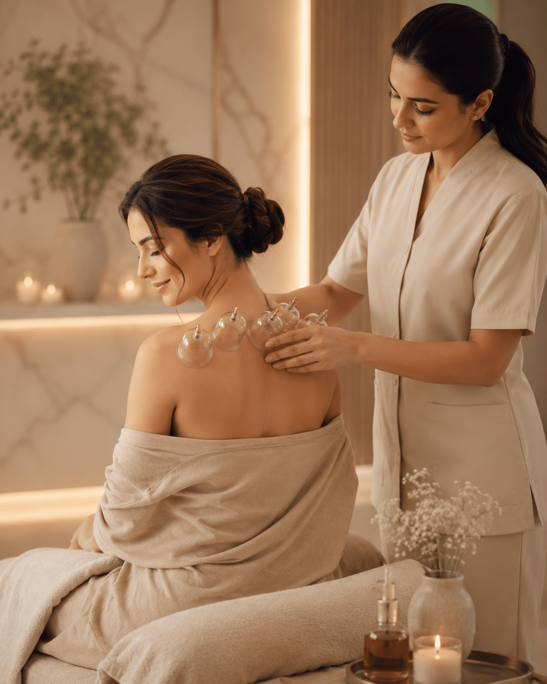
02
CHAPTER
The Hijama Practitioner
Role, Responsibility, and Excellence in Practice

Slide 10
M1 | SRA-001
Introduction to Hijama
SUNNAH REMEDIES
The Practitioner as Amanah-Holder
إِنَّا عَرَضْنَا الْأَمَانَةَ عَلَى السَّمَاوَاتِ وَالْأَرْضِ وَالْجِبَالِ
The Amanah in Practice
"Indeed, We offered the Trust to the heavens and the earth..."
— Qur'an 33:72
When a patient lies on your treatment table, they are vulnerable — physically exposed, seeking relief, placing their hope in your hands.
This is not merely a clinical transaction. It is a sacred trust (amanah) that Allah has placed upon you as a practitioner of healing.
The Prophet (peace be upon him) said: "Allah does not bestow a favour upon a servant and then take it away, but He tests him through it."
Your skill in Hijama is such a favour. Use it with excellence, integrity, and gratitude.
Amanah — the sacred trust. In Islamic ethics, it represents the profound responsibility entrusted to human beings. For the Hijama practitioner, this trust is lived out in every patient interaction: the patient entrusts their body, their health, and their dignity to your care.
ETHICAL IMPLICATIONS
1. Competence — You must be skilled before you touch a patient
2. Honesty — Never claim what you cannot verify
3. Confidentiality — What is shared in the clinic stays there
4. Compassion — Every patient deserves your full presence
5. Humility — Know your limits and refer when needed
10

Slide 11
M1 | SRA-001
Introduction to Hijama
SUNNAH REMEDIES
The SRA Amanah Framework
Five pillars define the trustworthy practitioner. Each pillar is non-negotiable — weakness in any one undermines the entire foundation.
1
Clinical Competence
2
Intellectual Honesty
3
Patient Safety Priority
Technical mastery of Hijama procedures. Sound anatomical knowledge. Evidence-informed practice. Recognition of personal limits.
Honest communication of evidence. No unsubstantiated claims. Clear distinction between what is proven, probable, and traditional.
Uncompromising safety standards. Rigorous infection control. Proactive risk management. Emergency preparedness.
4
Confidentiality and Respect
5
Continuous Improvement
Patient information protected. Dignity maintained in all interactions. Cultural sensitivity practised. The therapeutic relationship honoured as a sacred trust.
Lifelong learning commitment. CPD engagement. Reflective practice. Staying current with evidence. Seeking feedback and acting upon it.
This framework appears in the SRA Code of Ethics (SRA-CE-001) and is assessed throughout the programme.
11

Slide 12
M1 | SRA-001
Introduction to Hijama
SUNNAH REMEDIES
Ihsan in Clinical Practice
"Worship Allah as if you see Him, and if you do not see Him, know that He sees you."
Ihsan in Action
— Sahih Muslim, Hadith 8 (The Hadith of Gabriel)
The Prophet (peace be upon him) said:
"Indeed, Allah loves that when one of you does something, he does it with excellence (itqan)."
This is not perfectionism — it is conscious excellence. The practitioner who works with ihsan:
● Prepares meticulously before each patient
● Reviews their technique regularly
● Seeks feedback and acts on it
● Approaches every treatment as an act of service
Ihsan is the difference between a technician and a healer.
This is the definition of Ihsan — excellence in awareness of Allah.
What is Ihsan?
Ihsan (excellence) is the spiritual quality of doing everything with full awareness that Allah is watching. It transforms ordinary actions into acts of worship. For the Hijama practitioner, Ihsan means:
● Every incision is precise — because Allah sees your hand
● Every assessment is thorough — because Allah knows your intention
● Every interaction is compassionate — because the patient is an amanah
● Every decision is ethical — because Allah is the ultimate witness
12

Slide 13
M1 | SRA-001
Introduction to Hijama
SUNNAH REMEDIES
The SRA Competency Framework
Six domains define practitioner competence. Level 3 (Competent) is required in all domains for CHP certification.
Domain | Level 1: Foundational | Level 2: Developing | Level 3: Competent | Level 4: Proficient
Knowledge (Ilm) | Recalls facts | Explains concepts | Applies knowledge | Synthesises and teaches
Clinical Assessment | Identifies components | Performs with guidance | Performs independently | Adapts to complex cases
Technical Skills (Itqan) | Observes and describes | Practises with supervision | Performs competently | Refines and innovates
Safety Management (Hifz) | Recognises hazards | Applies protocols | Manages incidents | Prevents and educates
Communication (Kalam) | Listens actively | Communicates clearly | Adapts to context | Inspires and mentors
Professionalism (Amanah) | Understands ethics | Applies principles | Models excellence | Leads and influences
Certification Requirement: Level 3 (Competent) in all six domains — verified through written exam, OSCE, and portfolio.
13

Slide 14
M1 | SRA-001
Introduction to Hijama
SUNNAH REMEDIES
Professional Identity and Boundaries
THE CHP PROFESSIONAL IDENTITY
PROFESSIONAL BOUNDARIES
The Certified Hijama Practitioner is a complementary therapy professional who:
● Practises wet and dry cupping within a defined scope
● Integrates Islamic ethics with clinical standards
● Works collaboratively within healthcare system
● Maintains continuous professional development
Essential boundaries for ethical practice:
● No personal relationships with current patients
● No financial exploitation of patient vulnerability
● No advice contradicting patient's medical care
● No treatment without valid, informed consent
INTERPROFESSIONAL RELATIONSHIPS
CHPs work within a broader healthcare ecosystem. Building respectful relationships with GPs, physiotherapists, and other healthcare professionals is essential:
Referral to GP: Unexplained symptoms, red flags, conditions beyond scope | Collaboration: Integrated care plans with patient's consent | Communication: Professional letters, shared records (with consent)
PRACTITIONER WELLBEING
You cannot pour from an empty vessel. Maintain your own physical, mental, and spiritual wellbeing. Regular Hijama for yourself, proper rest, continuous learning, and peer support are not luxuries — they are professional necessities.
14

Slide 15
M1 | SRA-001
Introduction to Hijama
SUNNAH REMEDIES
Module 1: Summary and Key Takeaways
1
Hijama is Wet Cupping
2
CHPs Work Within Defined Scope
Controlled incision + negative pressure + blood extraction. Distinct from dry cupping and other modalities.
Clear boundaries on what can and cannot be done. When in doubt, refer. Patient safety is paramount.
3
Practice is Rooted in Amanah and Ihsan
4
Competency in Six Domains Required
The sacred trust of patient care and the pursuit of excellence in awareness of Allah.
Knowledge, assessment, technical skills, safety, communication, professionalism — all at Level 3.
5
Safety and Ethics are Non-Negotiable
The Amanah Framework and SRA Code of Ethics govern every aspect of practice.
COMING NEXT — MODULE 2
KNOWLEDGE CHECK
History of Cupping Around the World
Question: A patient asks you to diagnose their back pain. What is your response as a CHP?
Discuss in your Reflect–Learn–Apply journal.
From ancient Egypt to the Islamic Golden Age — tracing the scholarly history of cupping therapy across civilisations.
15

Slide 16
"Indeed, Allah commands you to render trusts to whom they are due."
— Qur'an 4:58
Reflection: How will you embody amanah in your practice as a Hijama practitioner?
MODULE 1 COMPLETE
SUNNAH REMEDIES · INSTITUTE OF PROPHETIC MEDICINE

